Slide 1
Project Proposal: “DIF-M (Do it For Me)”
An NLP Model to have empathetic outcomes for Product Development
CSE 499A
Ahmed Akib Jawad Karim (ID: 1911547042)
Anjana Tameem (ID: 1922076042)
Kazi Hafiz Md. Asad (ID: 1921880042
Notes:
Image: https://pixabay.com/illustrations/technology-artificial-intelligence-3762547/

Slide 2


The Problem and why it interests.
Most innovative products fails 75% after few days in the market. This is due to lack of quality enhancing developments of the products.
In Economic terms, There is Cobb-Douglas Function that gives the relation between quantities of physical input and quantities of output of goods.
Y=F(K,L,H,A,D)
Our Goal is to develop a model that can help an ‘Innovator’ to keep it’s product alive and develop it accordingly to the likings of the people’s preferences.
Empathetic approach to develop products
Here,
Y=Economic output
K=Knowledge
L= Labor
H= Human Capital
A= Idea
D= Decision making

Slide 3
The way that Idea bloom in our mind
When brainstorming ideas, we wanted to explore unexplored areas or areas that had previously been uncharted territory for us developers. We wanted to delve into this notion because it hasn't been addressed or researched much.
We also wanted the topic to be studied through NLP (Transfer Learning) or anything relevant to text generation models when going through suggestions. So we intended to include BERT, DistilBERT, or GPT-2 in our concept and in this idea we could explore these models.
Such thoughts led us to our unique concept.
Interesting fact
NLP can resolve ambiguity in language
DistilBERT
This DistilBERT is a small, fast, cheap and light Transformer model trained by distilling BERT base

Slide 4
A simple representation of the Model.
Input your Product: Back-Cover for iPhone-11
Do your query: What are the lacking? How to improve the product?
Product Reviews
DIF-M
Meta-Data
Output about your Product:
1. The quality of packet is very poor.
2.Make a reddish-brown case with matt finish and decrease it’s price by 2.5%

Slide 5




Working Plan
1. Preparing the Dataset
a) Converting our Json fomat based data into CSV format according to our likings of particular product or class of products also.
b) Dataset is pretty ideal, we have to remove false reviews by simple delete function.
2. Loading Models
DistilBERT (66M)
DistilGPT-2 (124M)
Bloom350M
4. Using Bloom Model with the inputs similar to our model. Then, Analyzing the results with Our Model.
No fine tuning in bloom
Fine tuning bloom with our dataset
3. Fine tunning on our data set
on DistilBERT and DistilGPT-2
Then, extract results with one specific inputs.

Slide 6
Dataset
Amazon review Data (2018)
Size:
i) 233.1M reviews (34gb)
ii) Ratings only (6.7gb)
iii) Meta Data – (12gb)
Meta Data has Descriptions, Category Information, Price, Brand and Image of the product.

Slide 7
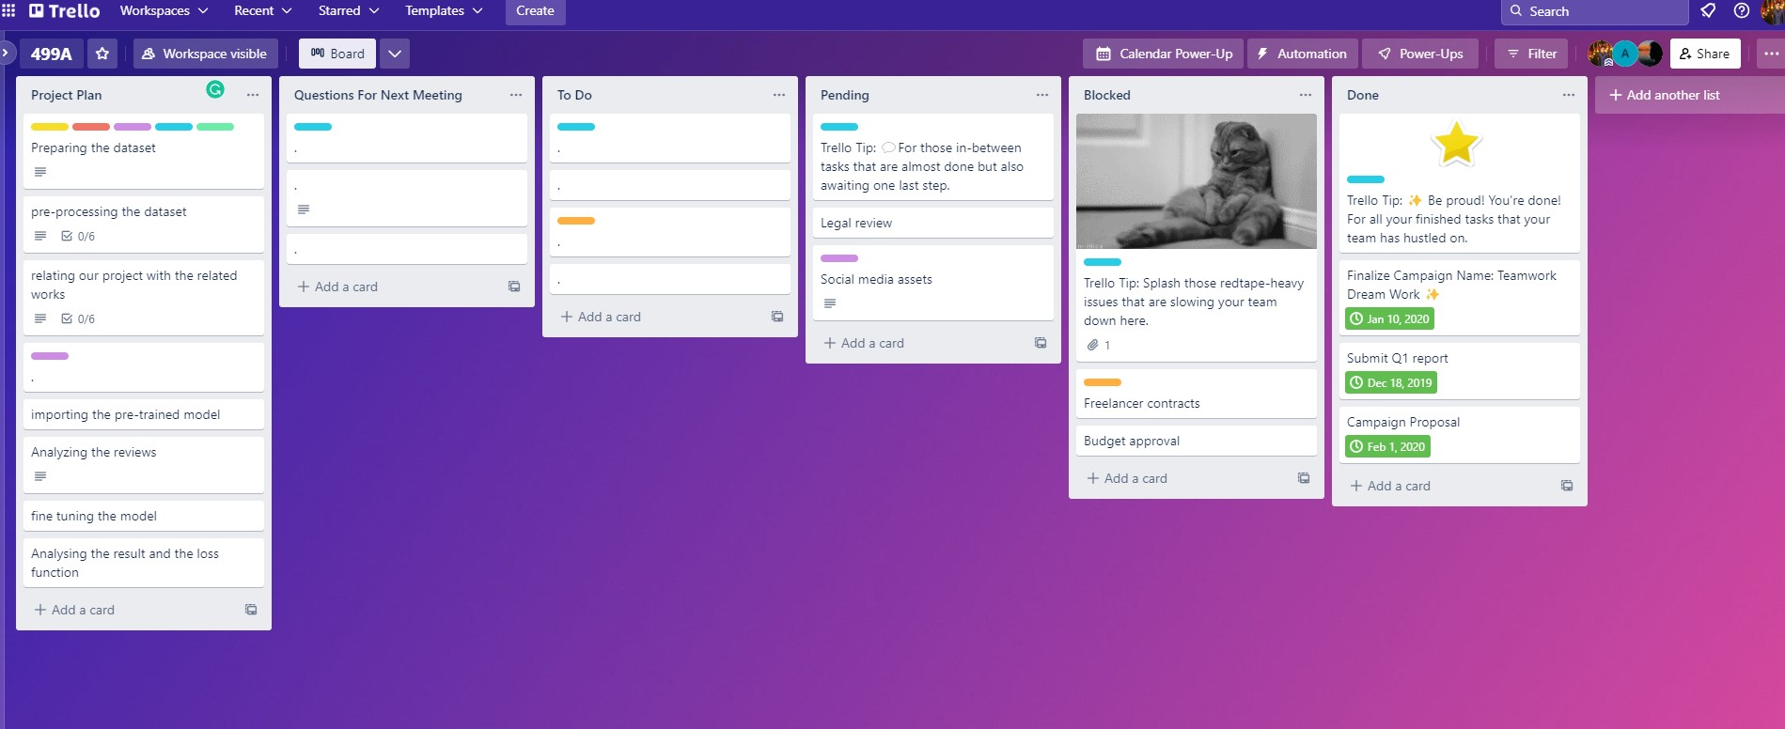
Working Plan

Slide 8
Related works
Applying Distilled BERT for Question Answering on ASRS Reports
Paper link: https://doi.org/10.23919/NTCA50409.2020.9291241
DistilBERT-based Argumentation Retrieval for Answering Comparative Questions
Paper link: http://ceur-ws.org/Vol-2936/paper-209.pdf
A Method For Answer Selection Using DistilBERT And Important Words
Paper link: https://doi.org/10.1109/ICWR49608.2020.9122302
Comprehension Based Question Answering using Bloom's Taxonomy
Paper link: https://arxiv.org/abs/2106.04653v1
Automatic Question Paper Generation, according to Bloom’s Taxonomy, by generating questions from text using Natural Language Processing
Paper link: https://ijisrt.com/assets/upload/files/IJISRT21APR580.pdf
A Short Study on Compressing Decoder-Based Language Models
Paper link: https://doi.org/10.48550/arXiv.2110.08460

Slide 9
Extensibility

Slide 10

THANK YOU

